Slide 1

Mini Project-I Presentation T.E. (CSE- AI & ML) Sem - V
Lokmanya Tilak College of Engineering, Navi Mumbai
Computer Science & Engineering(AI & ML)
2022-23

Slide 2

BIG MART SALES PREDICTION
Group members
SAUD ANSARI(AIML04)
SHASHANK BANGERA(AIML05)
VIVEK CHAURASIYA(AIML10)
VAISHNAVI NAGAONKAR(AIML36)
Project Guide
Prof. Kanchan Talekar

Slide 3
Presentation Outline
Abstract
Introduction
LITERATURE SURVEY
Data Requirements
Tool Used
Limitations of Existing System
Problem Statement
Proposed System
Flow Chart
Scope
Conclusion
References

Slide 4
ABSTRACT
The data scientists at Big Mart have collected 2013 sales data for 1559 products across 10 stores in different cities. Also, certain attributes of each product and store have been defined. The aim is to build a predictive model and find out the sales of each product given the set of attributes.

Slide 5
INTRODUCTION
The aim is to build a predictive model and find out the sales of each product at a particular store.
Using this model, Big Mart will try to understand the properties of products and stores which play a key role in increasing sales.
We will use Exploratory Data Analysis (EDA) to find the Key relations between different attributes and will use a ML algorithm to predict the future sales demand.
We can tell the company what are all the challenges they may face, what are the brands or products which is sold the most & other such kind of things, this helps sales team to understand which product to sell & which product to promote & other such kind of things.

Slide 6
LITERATURE SURVEY ​​
Authors | Title of the paper & year of publ. | Major contributions
Gopal Behera and Neeta Nain | A Comparative Study of Big Mart Sales Prediction September 2019 | Their technique can produce more accurate prediction compared to than other available techniques

Slide 7
Data Requirements
The data was provided by a user in Kaggle. The Store Sales Prediction data is recorded many product descriptions along with past sales quantity.
For building the ML model we will use the dataset that is given. The data consisted of 8523 rows and various information about products like:

Slide 8

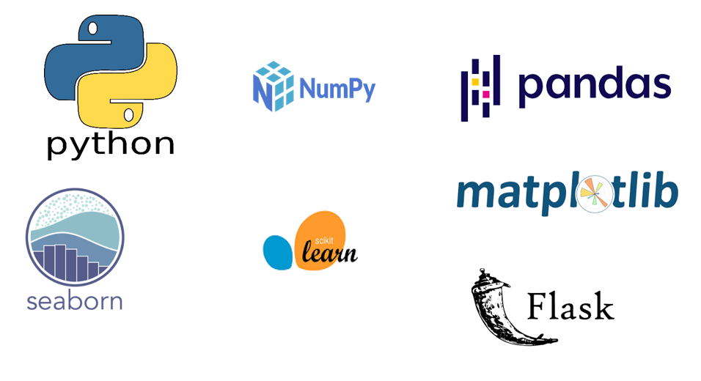
Tools Used

Slide 9
LIMITATION OF EXISTING SYTEM
The System should be user-friendly, the user should get all proper messages while using the web app.
User also should get a proper error message if a user has done something wrong on the web-app page.
All the errors and results should be delivered in the easiest possible way and all the buttons are going to insert on the webpage should be labelled properly, so the user did not get confused to use the system.

Slide 10
PROBLEM STATEMENT
Using this model, Big Mart will try to understand the properties of products and stores which play a key role in increasing sales.
The Data We have train (8523) and test (5681) data set, train data set has both input and output variable(s). You need to predict the sales for test data set..

Slide 11
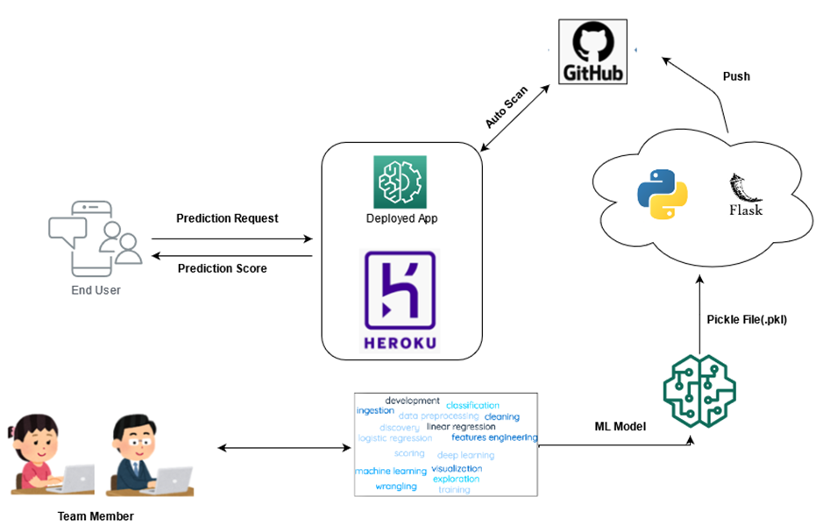
PROPOSED SYSTEM

Slide 12
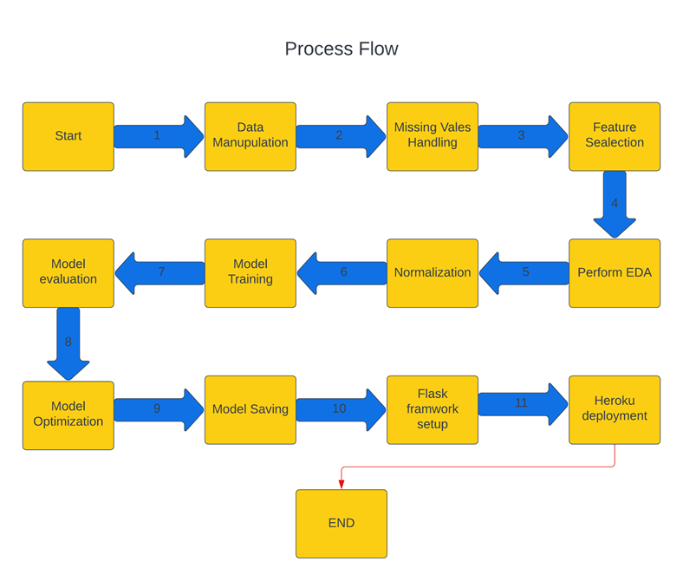
Process Flow

Slide 13
SCOPE
Big Mart will try to understand the properties of products and stores which play a key role in increasing sales.
They can also make several marketing plans let's say that a particular product in a particular store is getting sold the most & we may find some insights from it - as of why this product is getting sold the most & this helps the company to make better marketing decisions

Slide 14
CONCLUSION
The Store Sales Prediction can tell the company what are all the challenges they may face.
Item_MRP clearly maximises the Outlet sales.
Outlet Type being Supermarket or Grocery Store also represents the Outlet Sales.
Years Established will also tend to have loyal customers and that's how the sales margin can be achieved.

Slide 15
REFERENCES
Google images reference to showcase the framework/library used.
Lucid chart for drawing process flow and deployment process.
Data source: https://www.kaggle.com/brijbhushannanda1979/bigmart-sales-data

Slide 16
Thank You!

